Slide 1
Heart 2 heart sprint 3
Team members: Peter, Ye, Lan, Ziyu, Lorrie

Slide 2
Trello
https://trello.com/b/TaPGvRKv/heart-disease

Slide 3
Improvment
Original: Gaussian Filter
Improved Method: Mean Filter

Slide 4
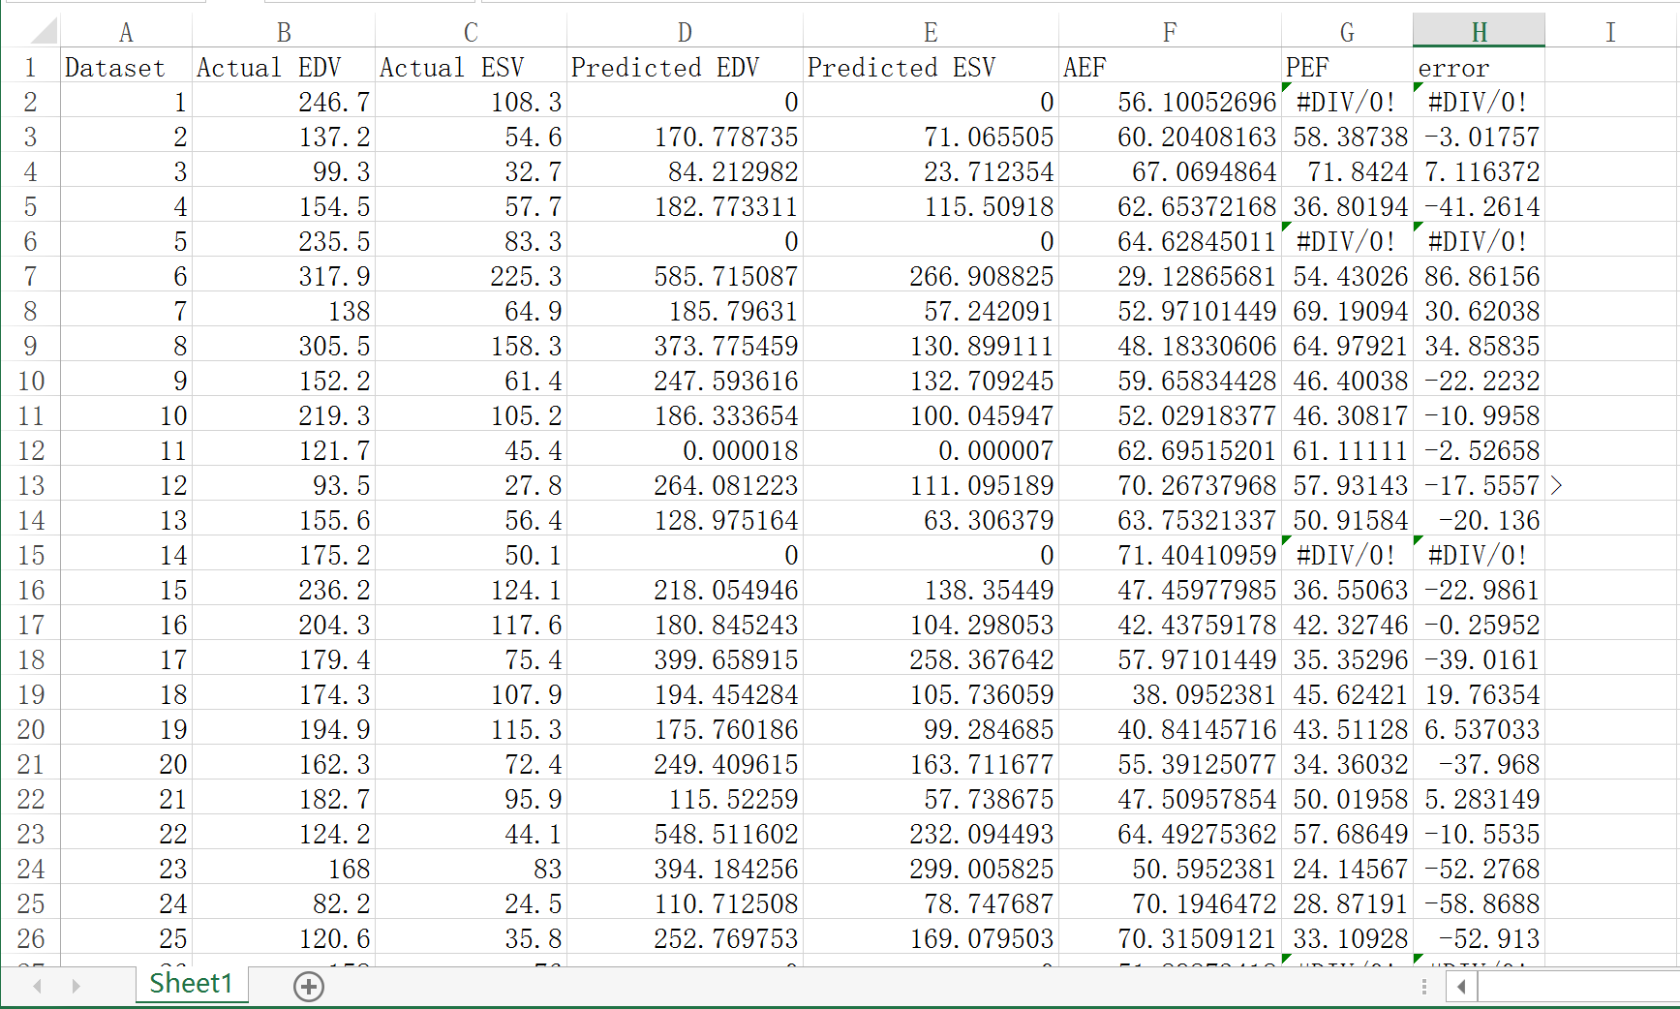
Program
Original Result

Slide 5
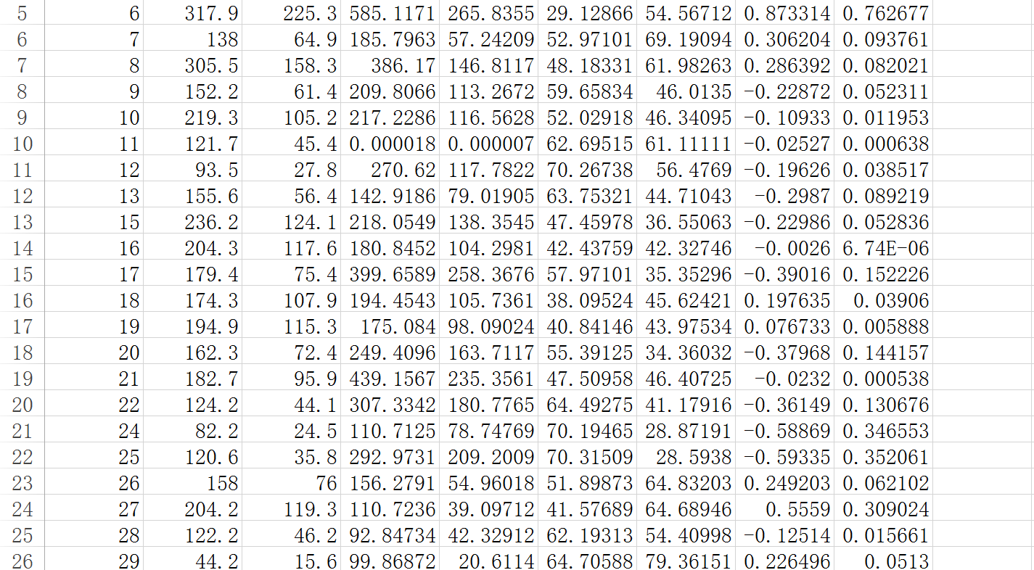
Program
Modified Result

Slide 6
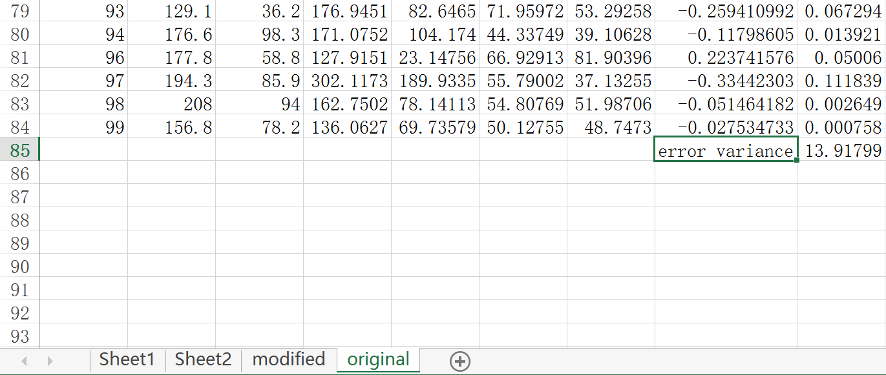
Program
Original Method Error Variance

Slide 7
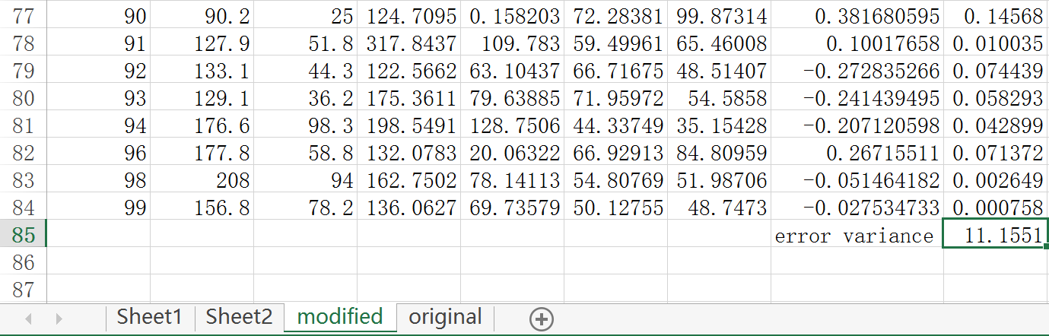
Program
Modified Method Error Variance

Slide 8
Next go: (sprint 4)
Finish the database part
Learn more materials about what we’ve got from the program and try to provide more information
Connect all parts together
Use test software to test our project
Improve the functions and the UI

